Slide 1
TMT Enabler Update V4.2
Enabler Guide
3 October 2024

Slide 2

Table of Contents
01
High Level Updates to the Enabler | 3
1.1 - The Purpose of the New Enabler Release 1.2 - v4.1 vs. v4.2: Transitioning to an Enhanced Data Pack 1.3 – The Updated Process Guide 1.4 – The Change Managment Strategy | 4 5 6 7
New Databook Views | 10
2.1 – New Databook Views | 12-14
How To Get Started With the Enabler | 15
3.1 – Process Overview | 16
The Strategic Future of the TMT Enabler
4.1 – A Future with no Alteryx? 4.2 – What Does the Python Code Look Like? | 16 17
The Product Team – The Dream Team | 17
5.1 – Meet the Team | 18
02
03
04
05

Slide 3
1
01. High-Level Updates to the Enabler

Slide 4
As of YTD August '24, the TMT Enabler has demonstrated strong adoption and proven value across client engagements
$6m
Enabler supported-revenue
25+
Deals supported by Enabler
20%
Enabler utilization %
(out of total TMT engagements)
The initial momentum reflects a solid foundation, with the team focused on driving further adoption and continuously enhancing the TMT Enabler guided by real-time feedback
Notes:
Dynamic Top Movers
Datamodel with better usability
Level 3 Retention
Renewal Analysis

Slide 5
The new Enabler release boosts team collaboration, accelerates data processing, streamlines onboarding, and adopts best-in-class solutions
The WHY
The HOW
Encourage global collaboration around feature development vs. “rebuilding the wheel” from deal to deal
01
Speed with
Snowflake
Efficiency in deals with larger datasets so that teams are not waiting around 1+ hour(s) for a workflow to run
02
Reduce friction ramping new team members with broadly deployed comprehensive documentation and training
Standard Usable
Databook + PBI
Templates
Common Training
Material
03
Leveraging and adopting best-in-class solutions to remain competitive and efficient
04

Slide 6
Significant enhancements delivered this development cycle with a focus on usability and performance, interactive databook capabilities, and more advanced analyses to drive deeper insights
Key improvements the development team have made
Usability and Speed
Optimized InDB SQL Code:
Faster processing time
Fewer data aggregation and summarization steps
Enhanced Usability (Databook & Alteryx)
Streamlined workflow
Easier user-modification with cleaner documentations
Dynamics Reporting Capabilities
Template-Based Approach
Linked to the same data model as PowerBI for consistency
Multi-Level Customer View
Easily adjust date ranges and segment top customers by any attribute or period
Bird's Eye View of KPIs
Sliceable analyses with flexible, dynamic schedules
Simplified Backend
Automated setup, instant connections, and DAX optimization for dynamic calculations
Enhanced / Enriched Analyses
KPI Matrix
Product Penetration / Cross-sell
Customer Migration
Renewal Rate Analysis
Customer Stratification by ARR
Notes:
Dynamic Top Movers
Datamodel with better usability
Level 3 Retention
Renewal Analysis

Slide 7
We have established clear steps for streamlining data processes, setting up Snowflake, and enhancing reporting to efficiently deliver insights to our clients.
Raw Data From Client
Set up Snowflake & Alteryx
Connect & Refresh Databook from Snowflake
Connect & Refresh PowerBI
Deliver Insights to Client
Capture and obtain bookings, billings, and/or other recurring revenue data.
Clean data and reconcile it to the client's trial balances or other reports.
Setup a new Project Snowflake instance and connect it with Alteryx.
Run the In-DB Alteryx Enabler
Build Snowflake final output tables
Connect Snowflake to Excel
Refresh data in Excel and update Databook tabs
Make any changes in the Databook based on specific deal needs.
Connect Snowflake to PBI
Refresh data in PBI and update Dashboard tabs
Make any changes in the Dashboard based on specific deal needs.
Leverage the outputs in the Databook and PBI to advice clients

Slide 8
Our change management strategy ensures smooth adoption through targeted training, support, usage tracking, and continuous feedback
Lunch & Learn
Schedule a Lunch & Learn to go over what the new Enablers is and how to leverage it on a deal.
Lunch & Learn
Office Hours
Host an enabler office hours to answer any questions and solicit feedback on areas of improvement
Office Champions
Office Hours
Office Champions
Leverage and empower office champions to provide guidance and assist on any questions.
Adaptation Strategy
Feedback Survey
Deploy feedback surveys on a periodic basis to solicit anonymous feedback on efficacy of enabler and areas of opportunities
Feedback Survey
Tracking Usage
Tracking Usage
Actively track usage and reach out to deal leads where an enabler instance was not used to receive continuous feedback for future development

Slide 9
2
03. New Databook Views

Slide 10
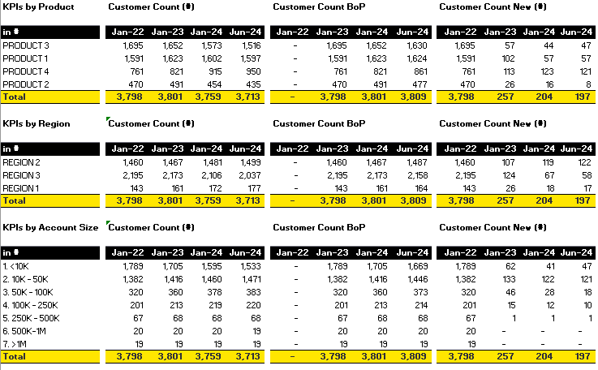
3.1 - New Databook Views
Enhanced KPI Matrix Views
Pillars | KPIs
Product | Customer Count
Region | Customer Count BoP
Account Size | Customer Count New (#)
Industry | Customer Count New (%)
Channel | Customer Count Churn (#)
Cohort | Customer Count Churn (%)
 | ARPU ($)

Slide 11
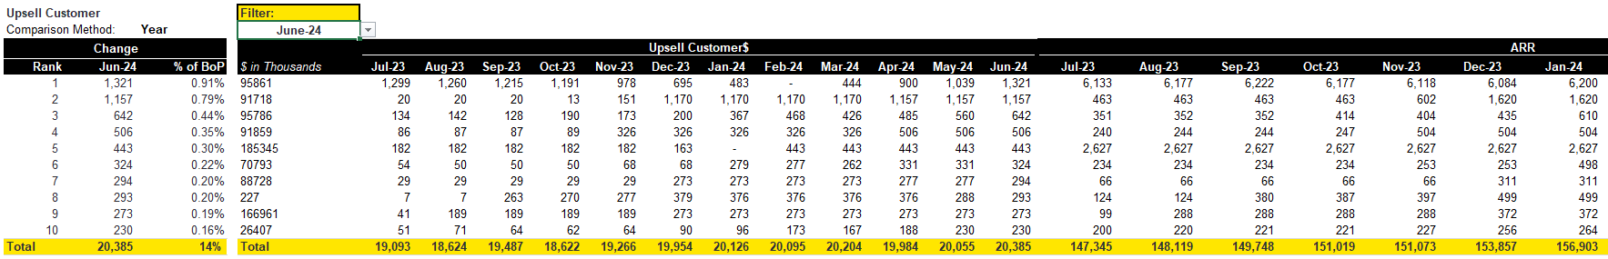
3.1 - New Databook Views
New Top Mover Views by New, Churn, Upsell, Downsell
Consolidated view of movement category $ and ARR $ figures
Dropdown selection to filter by diligence period
Consolidated ranking of Top 10 customers by ARR and % of BoP

Slide 12
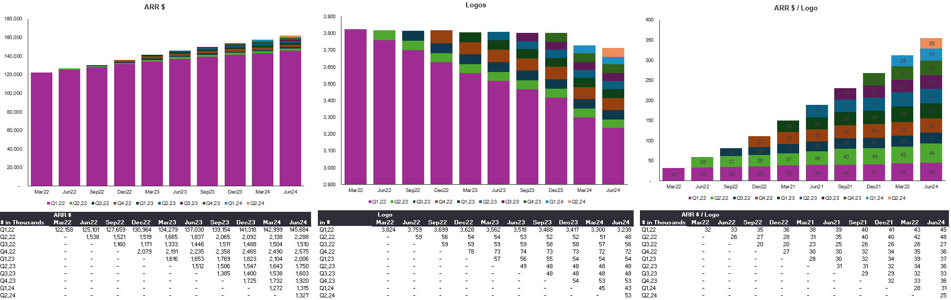
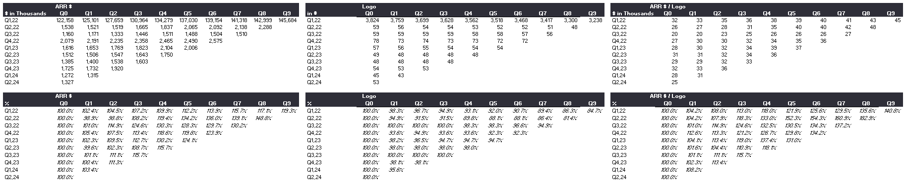
3.1 - New Databook Views
Refreshed Cohort Analyses

Slide 13
3
04. How To Get Started With The Enabler

Slide 14





4.1 - Process Overview
Process Overview
Raw Data From Client
Set up Snowflake
Connect & Refresh Databook from Snowflake
Connect & Refresh PowerBI
Deliver Insights to Client
Workflow Steps
Description
File/Folder Name
1 |  | TMT Enabler | Copy latest TMT enabler template folder into current project folder | Transaction Analytics - Tech Sector - General\V4.2 Tech Enabler Template (Final)\IN-DB - AFP
2 |  | Snowflake | Request Snowflake project setup through AFP Access Form and install ODBC driver Configure ODBC Data Sources to latest project
3 |  | Alteryx inDB | Configure Alteryx inDB Connections Run Alteryx In-DB workflows, Step 1, Step 2, and Step 3 | Options -> Advanced Options -> Manage InDB Connections Step 1 Data Prep Step 2 Retention Calcs Step 3 Databook
4 |  | Databook | 1. Data Ribbon -> Get Data -> From Other Sources -> From ODBC -> Select DSN (Data Source Name) -> Load To
5 |  | PowerBI | Refresh the Power BI dataset and load the fresh data | TMT Enabler_Retention Dashboard.pbix

Slide 15
4
02. Future of the TMT Enabler

Slide 16
2.1 - A Future with no Alteryx? (Might sound scary but it's not)
Missing anything?
Raw Data From Client
Set up Snowflake
Connect & Refresh Databook from Snowflake
Connect & Refresh PowerBI
Deliver Insights to Client
Capture and obtain bookings, billings, and/or other recurring revenue data.
Clean data and reconcile it to the client's trial balances or other reports.
Setup a new Project Snowflake instance
Run SQL/Python Enabler
Build Snowflake final output tables
Connect Snowflake to Excel
Refresh data in Excel and update Databook tabs
Make any changes in the Databook based on specific deal needs.
Connect Snowflake to PBI
Refresh data in PBI and update Dashboard tabs
Make any changes in the Dashboard based on specific deal needs.
Leverage the outputs in the databook and PBI to advice clients
Why move away from Alteryx completely?
Using Snowflake natively is even faster than using it in Alteryx.
Project Amsterdam with 1M+ customers took 3+ hours to run in Alteryx In-DB; however, with Python/SQL it took only 30 min. to run instead.
With more and more clients leveraging Snowflake and other SQL type tools, we can proficiently assist in building their own ARR retention analyses in-house. This means more outside diligence work and greater value-creation opportunities
Snowflake with Python/SQL is utilized more heavily in industry compared to Alteryx. This will help us attract better talent and provide accelerated professional development in their careers.
Greater flexibility in transforming data with the opportunity to productize our retention workflows for even more functionality.

Slide 17

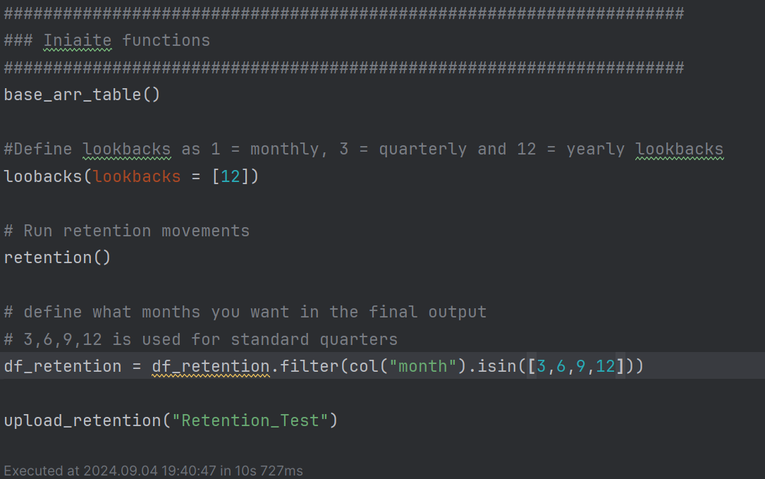
2.2 - What Does the Python Code Look Like?
Retention Functions built out to allow for easy use
Better collaboration with notebooks in snowflake
Easier retention bridge customization
Allow for more advanced analyses using snowflake libraries and other 3rd party libraries.
Using a true Analytics Tech Stack and infrastructure akin to what is used in the industry

Slide 18
5
05. The Product Team – The Dream Team

Slide 19



5.1 – Meet The Team
Add Peter And Manuel as the product team. Need to adjust photos
Arpeet Ravalji
Senior Manager
New York
arpeet.Ravalji@ey.com
Peter Chang
Associate
San Francisco
Peter.chang@ey.com
Manuel Barrios
Senior Associate
New York
manuel.taborga.barrios@ey.com

Slide 20
Thank you!

Slide 21
1.2 - v4.1 vs v4.2: Transitioning to an Enhanced Data Pack
Double check that we have everything there regarding features
Make sure that the number circles are all the same color.
What are the key accomplishments
v4.1
v4.2
Usability & Speed
1
Interactive Cohorts, & ARR Vintage Layer Cake
2
Product Migration
3
FX/Constant Currency option
4
Adjusted ARR & MRR Toggle
5
Cross-sell / Product Penetration Insights
6
KPI Matrix
7
* The data is for illustrative purposes only
Customer Stratification by ARR
8
Notes:
Dynamic Top Movers
Datamodel with better usability
Level 3 Retention
Renewal Analysis

